Slide 1


Milestone 3 Review
Analysis Phase Complete
Cost Data Integrity Project
November 29, 2007

Slide 2
Introduction
Analysis is focused on two critical to quality processes:
  Processing of Time Sheets
  Processing of Vendor Invoices
Major Analytical Steps:
  Identify Process Variables
  Compare Impacts – All Variables
  Apply Analytical Techniques
    Fish Bone & Five Whys
    Scatter Plots & Regression Analysis
    Analysis of Variances (ANOVA)

Slide 3
Root Causes
What variables have the biggest impact on improving the two critical processes?
Processing of Vendor Invoices (Critical Defect #1)
Processing of Time Sheets (Critical Defect #2)
Comparing / Reconciling to General Ledger Listing of Vendor Invoices
Receiving all monthly copies of invoices
Manual tracking of monthly recurring contract invoices
Manager review & approval of timesheets each pay period
Employee notifications of timesheets not entered

Slide 4
Sampling Plan
Describe the current sampling plan for the two critical processes
Focus on the high impact projects within the IT portfolio. Need to sample these projects on a continuous basis as follows:
Statistical sampling of timesheets every two weeks to drive control charts and subsequent project phases (improvement and control).
Statistical sampling of vendor invoices every month to drive control charts and subsequent project phases (improvement and control).
What is the expected time frame for sampling?
In order to ensure quality sampling, we are recommending that the team (or PMO staff) continue to pull samples well into next year. This will also help facilitate control and improvement over the two critical processes involved.

Slide 5
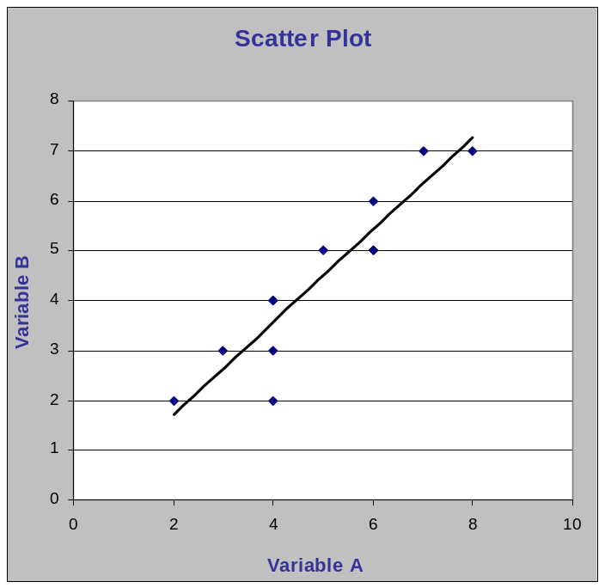
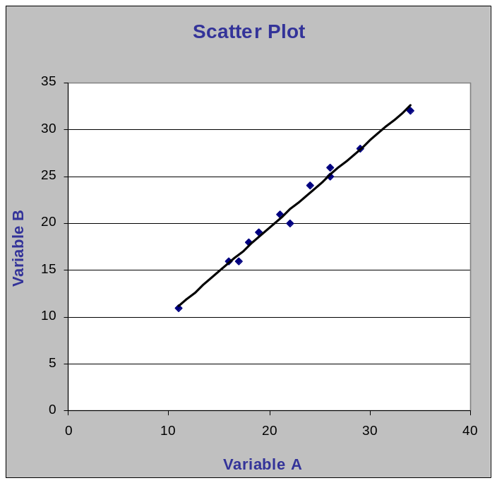
High Positive Correlations
Having projects reconcile contractor costs to the General Ledger improves the posting of invoices to PMS:
Having managers approve timesheets improves the posting of timesheets to PMS:

Slide 6
Z Test Results
Z Test: Measure the proportion of defects (status quo vs. alternative process)
Hypothesis | Test Statistic | Decision Criteria
Null (Status Quo): Invoices are posted to PMS regardless of what gets posted to the General Ledger Alternative: Reconciling to the General Ledger provides better insights into what must get posted into PMS and leads to fewer defects (missed invoices) | 6.00 | 2.33
Null (Status Quo): Timesheets are posted to PMS regardless if Managers are required to approve timesheets Alternative: Having managers approve timesheets leads to fewer defects (timesheets not posted) | 11.98 | 2.33
In both cases, the Test Statistic is higher than the Decision Criteria indicating that the Alternative process should be accepted!

Slide 7
ANOVA Results
ANOVA Test: Assess differences between various treatments
Critical Process 1: Vendor Invoices
Treatment 1 – Copies of all Vendor Invoices are Received each month | F Ratio = 7.75 F Distribution Value = 5.14
Treatment 2 – Projects reconcile and compare to the General Ledger
Treatment 3 – At least one person is trained in entering invoices
Critical Process 2: Timesheets
Treatment 1 – Managers approve timesheets | F Ratio = 3.79 F Distribution Value = 5.14
Treatment 2 – Mandatory training for employees on timesheets
Treatment 3 – 24 Hour Email Notification when not entered
Conclusion: There is a difference with invoice treatments, but not with timesheet treatments!

Slide 8
Project Performance
Is this project on schedule according to the project plan?
The project schedule has been revised to reflect fewer resources assigned. The new project schedule uses two assigned resources through February 2008. This extended schedule is necessary to facilitate sampling into the year 2008. Sampling on a very short duration is not producing normality.
This project should be completed in late February 2008. A final report should get released the first week March 2008.
Is this project on budget according to the project budget?
The project is under-budget since a few team members were pulled off the project temporarily for surge support work on other projects.
Total costs incurred to date (as of November 15, 2007) . $ 210,000 (40% spent)
Project Budget . . . . . . . . . . . . . . . . . . . . . . . . . . . . . . . . . . $ 522,000
Remaining Budget . . . . . . . . . . . . . . . . . . . . . . . . . . . . . . . $ 312,000

Slide 9

Questions and Comments

